Slide 1
Does A Medical Consortium Influence Health Outcomes of Hospitalized Cancer Patients?
An Integrated Care Model in Shanxi, China
Miao Cai, M.S.

Slide 2
Hospital system in China

Slide 3
1. Background
Vertical Integration
A Medical Consortium is a vertical integrated care that involves one widely recognized tertiary hospital and several secondary hospitals or community health centers.
June 2014 – Dec 2014: a pilot of 10 medical consortiums
A Tertiary Hospital
Secondary hospitals
Secondary hospitals
……
Primary hospitals……
Community health centers……

Slide 4
My question
?
Medical consortium policy
Cancer patients’ outcomes

Slide 5
Population
Cancer: the leading cause of death in China
Lung cancer, stomach cancer, and esophageal cancer → the most commonly diagnosed cancers in both men and women
Shanxi Provincial Cancer Hospital → 15 secondary hospitals
The aim of medical consortium policy is to improve the medical quality for lower level hospitals → maybe we should focus on patients in secondary hospitals

Slide 6

2. Data
Treatment group
Control group
Shanxi Provincial Cancer Hospital
Data: Electronic medical records of lung cancer (n = 8193), stomach cancer (n = 5693) and esophagus cancer (n = 2802) patients hospitalized in secondary hospitals during January 2015 and December 2015
Sample matching: Propensity scores were performed for one to one matching.
After matching: 1598*2 for lung cancer, 1008*2 for stomach cancer and 451*2 for esophagus cancer
Secondary hospitals
Secondary hospitals
Other secondary hospitals
…
…

Slide 7
3. Statistical models
Outcome: survival days in the hospitals and whether they are recovered or not
Kaplan-Meier survival curves
Cox proportional hazard models were used to estimate the hazard ratio of patients enrolled different categories of hospitals. Controlling variables include gender, age, comorbidities (C3 index), urgency of disease, and surgery.
Test of Assumptions: the proportional hazards assumption was evaluated by the Empirical Score Process with cumulative sums of martingale-based residuals

Slide 8
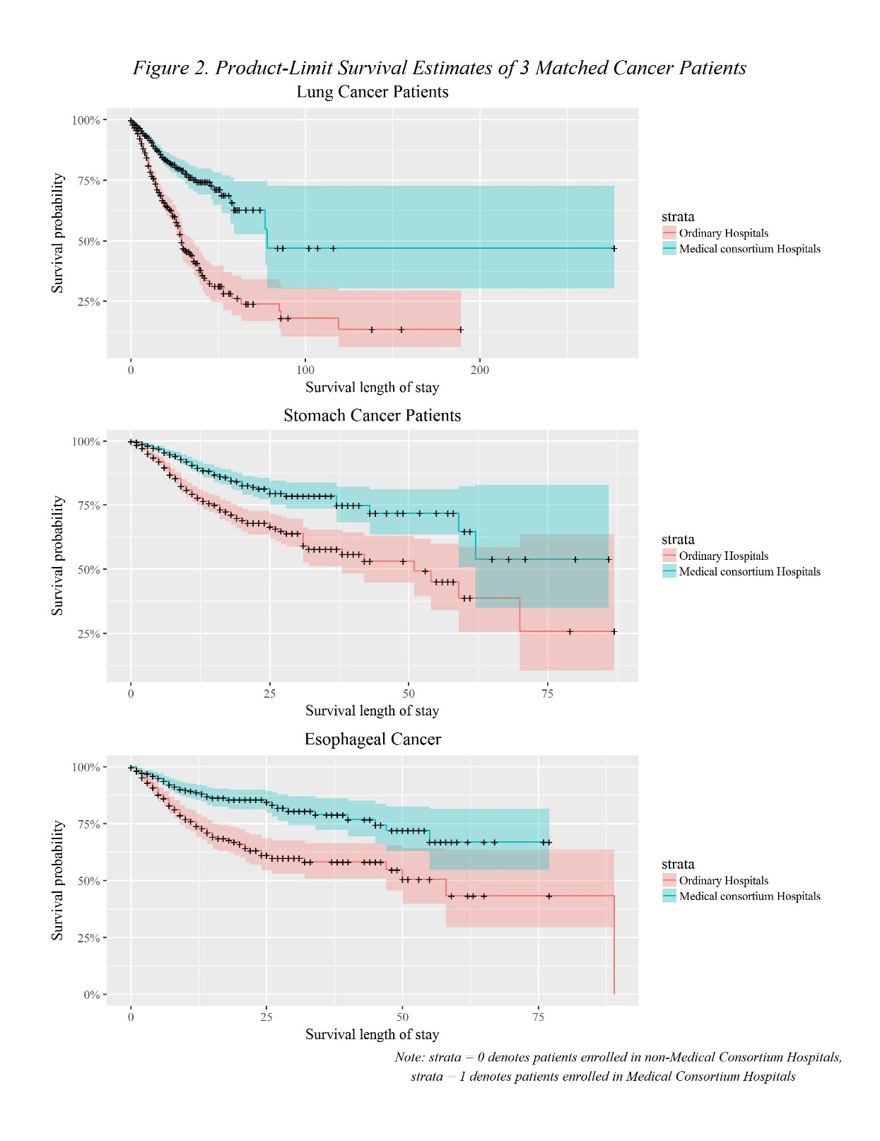
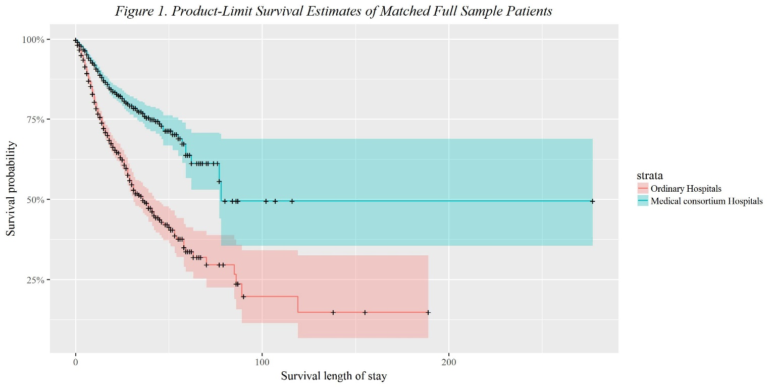
3. Results

Slide 9
3. Results
Results: significantly lower hazard ratios were consistently associated with cancer patients in medical consortium hospitals, compared with those in non-medical consortium hospitals.
Lung cancer patients: hazard ratio = 0.405, p < 0.001
Stomach cancer patients: HR = 0.406, p < 0.001
Esophagus cancer patients: HR= 0.439, p < 0.001

Slide 10
What did they do?
The expert team built specifically for this cancer medical consortium
Further education and specialized training for doctors in secondary hospitals
The two-way referral system
The Shanxi Provincial Hospital has provided specialty consulting service for 320 cases, and guided 30 surgeries on the spot in consortium secondary hospitals by the end of March in 2015

Slide 11
Concerns
For experts who intermittently work in secondary hospitals, how are they paid? Any incentives?
For tertiary hospitals, are they really helping the secondary hospitals? Or they are just expanding their territories?
Integrated care and market competition?

Slide 12
Conclusion
The medical consortium provides an effective strategy to improve the outcomes of cancer patients in Shanxi, China.

Slide 13
Limitations
No information on patients prior to the policy
Length-of-stay in hospitals might be too short to assess their survival
Only patients hospitalized one year after the policy intervention were included
Patients might be transferred from tertiary hospitals. They have better outcomes because they received treatment from tertiary hospitals instead of the secondary hospitals.

Slide 14
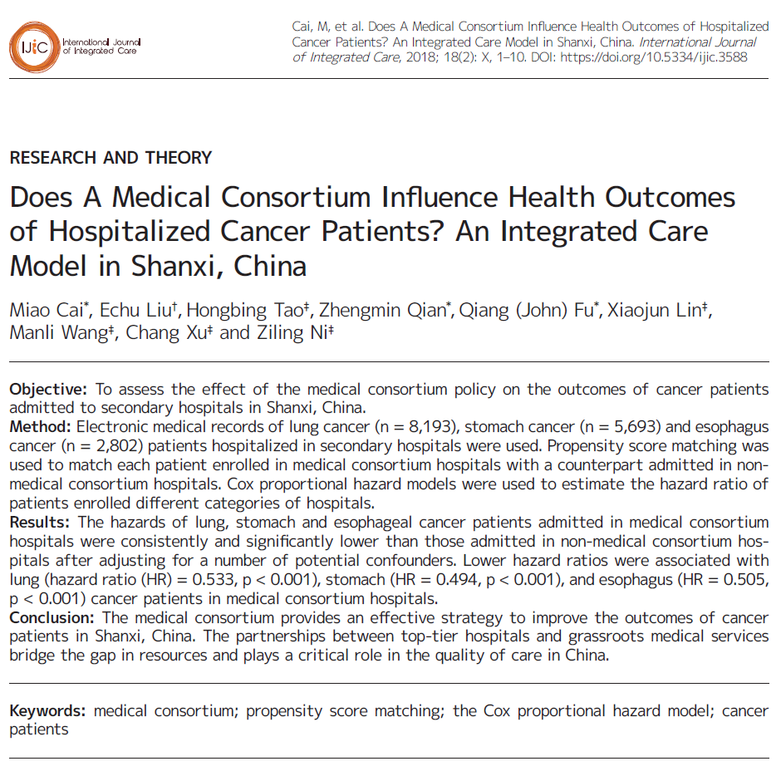
Reference
Cai, M., Liu, E., Tao, H., Qian, Z., Fu, Q. J., Lin, X., ... & Ni, Z. (2018). Does A Medical Consortium Influence Health Outcomes of Hospitalized Cancer Patients? An Integrated Care Model in Shanxi, China. International Journal of Integrated Care, 18:7. DOI: http://doi.org/10.5334/ijic.3588

Slide 15
Q & A

